Slide 1
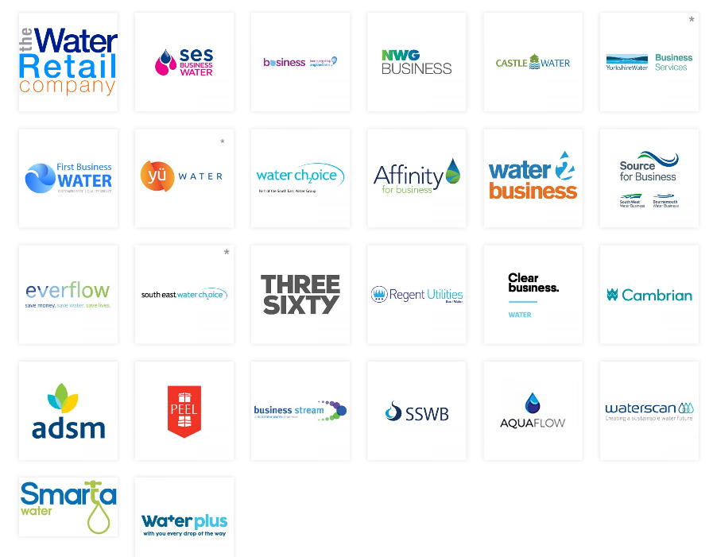
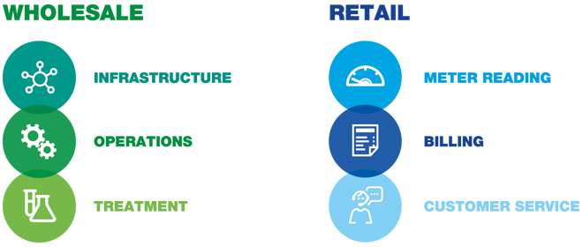

In April 2017, the water market spilt for business customers
Businesses can now shop around for retail water services
Yorkshire Water is the wholesale supplier of water and sewage services to the region
Retail services include customer services and metering this is provided by your water retailer

Slide 2
We, Yorkshire Water must submit a plan to Ofwat, the water regulator, in September this year.
This plan outlines what goals and commitments our customers have told us they want from their wholesale services for the years 2020-2025.
We have engaged with almost 30,000 household and business customers in the development of this plan, we are confident that we have listened to our diverse range of customers and created a plan customers want and need.
We must consult with our customers and stakeholders on our final plan to ensure you are happy with the content and the direction of the business for the five year period, and more importantly, you are happy with the cost of delivering this wholesale service to you.

Slide 3

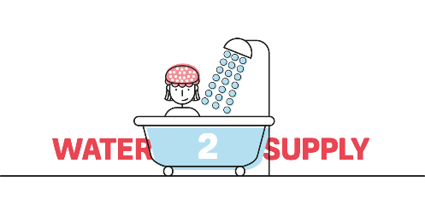

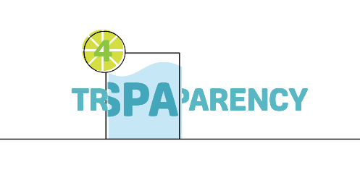
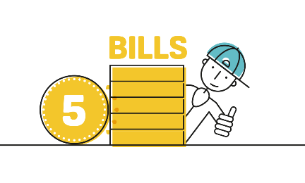
Our customers have told us that these 5 Big Goals are important to them so we’ve built our plan around these
WE WILL DEVELOP THE DEEPEST POSSIBLE UNDERSTANDING OF OUR CUSTOMERS’ NEEDS AND WANTS AND ENSURE THAT WE DEVELOP A SERVICE TAILORED AND PERSONALISED TO MEET THOSE NEEDS
WE WILL ALWAYS PROVIDE YOU WITH ENOUGH SAFE WATER, WE WILL NOT WASTE WATER AND ALWAYS PROTECT THE ENVIRONMENT
WE WILL REMOVE SURFACE WATER FROM OUR SEWERS AND RECYCLE ALL WASTE WATER, PROTECTING THE ENVIRONMENT FROM SEWER FLOODING AND POLLUTION
WE WILL BE A GLOBAL BENCHMARK FOR OPENESS AND TRANSPARENCY
WE WILL USE INNOVATION TO IMPROVE SERVICE, ERADICATE WASTE AND REDUCE COSTS SO NO ONE NEED WORRY ABOUT PAYING OUR BILL. WE WILL NOT WASTE MONEY

Slide 4
WE WILL DEVELOP THE DEEPEST POSSIBLE UNDERSTANDING OF OUR CUSTOMERS’ NEEDS AND WANTS AND ENSURE THAT WE DEVELOP A SERVICE TAILORED AND PERSONALISED TO MEET THOSE NEEDS
What this means for our customers over the next 5 years
We will excel in customer service
We will reduce debt owed to the company by identifying non-payers and empty properties (so we’re not wasting time and money charging and chasing payments)

Slide 5
WE WILL ALWAYS PROVIDE YOU WITH ENOUGH SAFE WATER, WE WILL NOT WASTE WATER AND ALWAYS PROTECT THE ENVIRONMENT
What this means for our customers over the next 5 years
We will reduce leaks by 40% by 2025
We will reduce water interruptions for customers, becoming a leader in the industry
We will improve our water appearance so fewer customers need to contact us about the taste, smell or colour of it
We will reduce our impact on the environment by recycling the water we use and using rain water where drinking water isn’t needed.
We will save 5% of our drinking water by working with large businesses in Yorkshire to change the way they use water in their own processes for example, using recycled water rather than drinking water
We will continue to work with our customers to reduce water use

Slide 6
WE WILL REMOVE SURFACE WATER FROM OUR SEWERS AND RECYCLE ALL WASTE WATER, PROTECTING THE ENVIRONMENT FROM SEWER FLOODING AND POLLUTION
What this means for our customers over the next 5 years
By 2020 we will have already reduced sewer leaks by 40% and reduced sewer flooding inside properties by 70% we will continue to reduce this throughout 2020-2025,
We will help reduce flooding by planting 1 million trees which will reduce the amount of rainfall running from our hills in to our towns and cities during storms.
We will conserve and enhance our land to improve biodiversity and land health, as well as reducing the spread of intrusive plants and creatures in our region
We will work with others to improve Yorkshires’ natural resources (air, soil, water and living things).
We will do significantly more to improve the quality of river and sea water in Yorkshire.
We will reduce our carbon emissions and increase the volume of renewable energy we generate
We will stop rain water running in to our sewers from 40 hectares of land, reducing the risk of flooding
We will create a waste water drainage plan for every village, town and city at risk of flooding in Yorkshire

Slide 7
WE WILL BE A GLOBAL BENCHMARK FOR OPENESS AND TRANSPARENCY
What this means for our customers over the next 5 years
We will become an ‘Open Data’ company – we will report openly on our performance in areas which are important to our customers such as leakage, pollution and sewer flooding
We will report on inclusion and diversity areas such as the gender pay gap
We will have a clear corporate and financing structure that is easy to understand and is trusted
Customers will have a clear view of what the bill payment is used for
Our data is recognised as trusted and accurate
People believe Yorkshire Water is a responsible company
We will play a wider role in society and be able to measure the benefits we add to Yorkshire

Slide 8
WE WILL USE INNOVATION TO IMPROVE SERVICE, ERADICATE WASTE AND REDUCE COSTS SO NO ONE NEED WORRY ABOUT PAYING OUR BILL. WE WILL NOT WASTE MONEY
What this means for our customers over the next 5 years
We will always have one of the lowest water bills in the country by ensuring we deliver the most efficient and innovative wholesale service possible to our customers (we currently have the second lowest bill in the water sector)
Bills will be kept low by working with partners on schemes which will benefit Yorkshire, allowing us to pool our finances and resources
We will generate additional income by using our waste or under-used resources better, this additional income will help to keep bills low.

Slide 9
WE WILL DEVELOP THE DEEPEST POSSIBLE UNDERTANDING OF OUR CUSTOMERS’ NEEDS AND WANTS AND ENSURE THAT WE DEVELOP A SERVICE TAILORED AND PERSONALISED TO MEET THOSE NEEDS
How we’ll measure our progress and if we’ve been successful from 2020-2025
Our CUSTOMER commitments based on customer feedback
Measure | Description | 2020 Position | 2025 Position | % Change | Incentive Type
Reducing company debt by identifying empty houses | Identifying empty properties in the region makes sure that everyone using water pays for water, this means that your bills are kept low. Every year we will make sure that 85% of the properties registered as vacant or uninhabited have been verified as empty, if not they will be billed | 80% | 85% | 6% | Reputational Incentive
Customer Experience/Satisfaction (D-MEX) | We will improve customer experience and increase the level of satisfaction with our service. This will be measured using an independent customer survey run by Ofwat, the measure will be the % of customers who rate the service as good, very good or excellent | Unknown | Unknown | Unknown | Financial Penalty & Reward

Slide 10
WE WILL ALWAYS PROVIDE YOU WITH ENOUGH SAFE WATER, WE WILL NOT WASTE WATER AND ALWAYS PROTECT THE ENVIRONMENT
Our WATER SUPPLY commitments based on customer feedback
How we’ll measure our progress and if we’ve been successful from 2020-2025
Measure | Description | 2020 Position | 2025 Position | % Change | Incentive Type
Drinking Water Quality | We will deliver a continuous high standard of drinking water quality. This is measured using the Drinking Water Inspectorate’s Compliance Risk Index . We will continue to reduce this score, a lower risk score means that there is a lower risk of a water quality problem. | 3.38 | 2.47 | -18% | Financial Penalty
Interruptions to water supply | We will continue to reduce the number of minutes customers are without water due to interruptions. This is measured in minutes without water longer than 3 hours per property | 4 mins | 2 mins | -50% | Financial Penalty & Reward
Leakage | We will continue to reduce the amount of water lost though leaks on our network. This is measured in ‘millions of litres lost per day’ | 235 million litres | 175 million litres | -25% | Financial Penalty & Reward
Unplanned loss of water production | We will reduce incidents where we lose the ability to produce water from our treatment works (e.g. when equipment fails). This is measured by ‘millions of litres lost’ | Unknown | Unknown | Unknown | Reputational Incentive
Repairing our water mains | We will continue to improve the condition of our pipes to reduce the amount of water lost and the number of times they need to be repaired. This is measured by the number of burst pipes repaired per 1000km of pipe | 265 bursts repairs | 220 bursts repairs | -17% | Financial Penalty & Reward

Slide 11
*continued
WE WILL ALWAYS PROVIDE YOU WITH ENOUGH SAFE WATER, WE WILL NOT WASTE WATER AND ALWAYS PROTECT THE ENVIRONMENT
Our WATER SUPPLY commitments based on customer feedback
How we’ll measure our progress and if we’ve been successful from 2020-2025
Measure | Description | 2020 Position | 2025 Position | % Change | Incentive Type
Customer water consumption | We will help our customers to reduce the water they use on a daily basis. We will measure in litres per day, the average water used by each property every day in the Yorkshire region | 125 litres per day | 119 litres per day | -4% | Financial Penalty & Reward
Customer contacts due to water quality concerns | We will reduce the number of customer contacts relating to water quality issues. This will be measured by the number of customer contacts received regarding taste, colour or smell of water | 6,308 contacts per year | 6070 contacts per year | -4% | Financial Penalty & Reward
Interruptions to water supply lasting more than 12 hours | We will reduce the number of occasions that customers are without water. This is measured by the number of times where customers have an interruption longer than 12 hours | 15 incidents per year | 12 incidents per year | -20% | Financial Penalty & Reward
Low pressure | We will reduce the number of properties experiencing low pressure. This is measured by the number of properties below the low pressure standard | 15 properties | 12 properties | -20% | Financial Penalty & Reward

Slide 12
*continued
WE WILL ALWAYS PROVIDE YOU WITH ENOUGH SAFE WATER, WE WILL NOT WASTE WATER AND ALWAYS PROTECT THE ENVIRONMENT
Our WATER SUPPLY commitments based on customer feedback
How we’ll measure our progress and if we’ve been successful from 2020-2025
Measure | Description | 2020 Position | 2025 Position | % Change | Incentive Type
Educating our customers | We provide an education programme aimed at children and adults to raise awareness and understanding of our services and processes, to educate them how to use water and wastewater systems wisely. The measure will be the number of learning hours provided to customers | 17,500 hours provided | 20,000 hours provided | 14% | Financial Penalty
Recycling the water we use | We will reduce our impact on the environment by recycling the water we use and use rain water where treated water isn’t needed. The measure will be the volume of water we reuse or recycle per day | 0 | 8.5 million litres of water | NA | Financial Penalty & Reward
Our risk of a drought | This assesses the risk of customers experiencing water restrictions (such as standpipes in streets) as a result of a severe drought. This is measured by the percentage of population at risk of experiencing restrictions in a 1 in 200-year drought. Currently there is no risk of water restrictions to the people of Yorkshire should a 1 in 200 year drought occur. | 0% - no risk | 0% - no risk | 0% | Reputational Incentive
Water taken from environmentally sensitive places | Some water companies must take water from delicate places (e.g. specific rivers) where the impact of doing this might damage the environment. In Yorkshire we do not take water from sites that have been designated as environmentally sensitive, so we have not applied a target to this performance commitment. | 0 litres taken | 0 litres taken | 0 | Financial Penalty & Reward

Slide 13
WE WILL ALWAYS PROVIDE YOU WITH ENOUGH SAFE WATER, WE WILL NOT WASTE WATER AND ALWAYS PROTECT THE ENVIRONMENT
Our ENVIRONMENT commitments based on customer feedback
How we’ll measure our progress and if we’ve been successful from 2020-2025
Measure | Description | 2020 Position | 2025 Position | % Change | Incentive Type
Conserving and enhancing our land | We will continue to improve areas of our land which are important for nature and conservation. This will be measured in hectares of land improved | 11,700 | 15,000 | 30% | Financial Penalty & Reward
Catchment management | A catchment is an area of land where water flows into rivers or reservoirs. Management of a catchment will affect the quality of water we collect and supply. We will work in partnership with organisations like Natural England to make sure that the land is managed well. This will be measured by the number of catchments where we have an operational presence and a plan in place to protect the environment. | 0% | 7.7% | NA | Reputational Incentive
Improving Yorkshires rivers | We are responsible for helping to keep Yorkshire’s rivers clean. We make improvements to river water quality to keep it as close to its natural state as possible. Our aim is to improve river water to achieve good or high ecological status as determined by the Environment Agency. This will be measured by the number of kilometres of river water improved | 528 km of river improved | 768 km of river improved | 45% | Financial Penalty & Reward
Protecting our native species | Invasive plants and fish can impact the quality of our land and waters. It is our aim to ensure we do not contribute to the spread of non-native plants and animals. This measure will aim at reducing the spread of intrusive species by removing the ability for them to spread. The measure will be the number of projects we implement to help protect our native species | 0 | 12 | NA | Reputational Incentive
Reducing our carbon footprint | We will reduce the total amount of carbon emissions and green house gases created by our business and contained in our land. Our carbon emissions will be measured and reported in tonnes of carbon emitted | 249 tonnes of carbon | 220 tonnes of carbon | -12% | Financial Penalty & Reward

Slide 14
*continued
WE WILL ALWAYS PROVIDE YOU WITH ENOUGH SAFE WATER, WE WILL NOT WASTE WATER AND ALWAYS PROTECT THE ENVIRONMENT
Our ENVIRONMENT commitments based on customer feedback
How we’ll measure our progress and if we’ve been successful from 2020-2025
Measure | Description | 2020 Position | 2025 Position | % Change | Incentive Type
Minor pollution incidents | Pollution can happen when sewage escapes from our network of pipes in to rivers and streams. This measure is the number of minor pollution incidents caused. A minor incident will have a minor or minimal impact on the environment | 174 | 157 | -10% | Financial Penalty & Reward
Sewage flooding inside homes or businesses | When our assets fail it can cause sewage to flood the inside of customers properties. This measure is the number of incidents of internal sewer flooding of homes and businesses in a year | 582 | 346 | -41% | Financial Penalty & Reward
Sewage flooding outside homes or businesses | When our assets fail it can cause sewage to flood customers gardens or an area close to properties. This measure is the number of incidents of external sewer flooding of homes and businesses in a year | 7,566 | 6,375 | -16% | Financial Penalty & Reward
Treatment work compliance | We return treated waste water to the environment. The treated wastewater has to meet standards set by the Environment Agency, this ensures that we maintain the ecology of Yorkshire’s rivers and streams. The measure will be the number of failing treatment works | 5 failing treatment works | 4 failing treatment works | -20% | Financial Penalty & Reward
Sewer collapses | Not looking after our sewers properly can mean they can collapse, we will reduce the number of collapsed sewers we experience. The measure will be the number of collapses per 1000km of sewer pipe | 26.36 collapses per 1000km/pipe | 25.04 collapses per 1000km/pipe | -5% | Financial Penalty & Reward

Slide 15
*continued
WE WILL ALWAYS PROVIDE YOU WITH ENOUGH SAFE WATER, WE WILL NOT WASTE WATER AND ALWAYS PROTECT THE ENVIRONMENT
How we’ll measure our progress and if we’ve been successful from 2020-2025
Our ENVIRONMENT commitments based on customer feedback
Measure | Description | 2020 Position | 2025 Position | % Change | Incentive Type
Risk of sewer flooding during heavy rainfall | We will reduce the chance of sewer flooding during heavy rainfall in a 1 in 50 year rainfall event so there is a 2% chance of it happening in any one year. This is measured by the percentage of customers at risk of flooding in a 1 in 50 year rainfall event. Whilst we aim to reduce the percentage of the population impacted by sewer flooding, due to population increase, climate change and severe weather events we forecast that the percentage is likely to increase | 26% at risk | 27% at risk | 3% | Reputational Incentive
Improving Yorkshire’s bathing beaches | The quality of water at our 19 designated bathing beaches is monitored and measured every year. Our aim is to receive the highest possible award for the bathing water on the Yorkshire coast. The measure will the number of bathing beaches in Yorkshire that exceed the requirements of the European bathing water standards. | 15 out of 19 | 16 out of 19 | 7% | Financial Penalty & Reward
Volume of surface water reduced or removed from sewers | We want to reduce the amount of rain water entering the system to reduce flooding risk. This measure is the number of hectares of surface water removed/reduced from the sewer as a result of community rain gardens for example, or voluntary surface water disconnection from homes and businesses | 0 | 40 hectares of land | NA | Financial Penalty & Reward
Quality Agricultural Products | Agricultural biosolids are a by-product of our wastewater treatment operations. When treated and processed it can be recycled and used on agricultural land. Our aim is to produce biosolids of a consistent quality suitable for agricultural use. This measure is the percentage of biosolids which achieves Biosolids Assurance Scheme accreditation | 99% achieving accreditation | 100% achieving accreditation | 1% | Financial Penalty
Renewable energy generation | Biogas is a form of renewable energy, it is a by-product of our wastewater treatment process. By investing in the production of biogas we are taking less electricity from the grid to operate our treatment sites, this helps to keep your bill low. We will measure this by the kilowatt hours of energy generated from the biogas we produce | 378 kwh | 464 kwh | 23% | Reputational Incentive

Slide 16
WE WILL BE A GLOBAL BENCHMARK FOR OPENESS AND TRANSPARANCY
Our customers told us they expect Yorkshire Water to be more open and honest than any other company they deal with, because our customers can’t choose another water supplier for their wholesales services.
We’ve listened to this feedback and developed a Transparency Big Goal. Whilst there is no regulatory commitment for us to undertake the following commitments, we will strive to achieve the commitments and report on them, just like all the other performance commitments we publish:
What this means for our customers over the next 5 years
We will become an ‘Open Data’ company – we will report openly on our performance in areas which are important to our customers such as leakage, pollution and sewer flooding
We will report on inclusion and diversity areas such as the gender pay gap
We will have a clear corporate and financing structure that is easy to understand and is trusted
Customers will have a clear view of what the bill payment is used for
Our data is recognised as trusted and accurate
People believe Yorkshire Water is a responsible company
We will play a wider role in society and be able to measure the benefits we add to Yorkshire

Slide 17
WE WILL BE A GLOBAL BENCHMARK FOR OPENESS AND TRANSPARANCY
Our BILLS commitments based on customer feedback
How we’ll measure our progress and if we’ve been successful from 2020-2025
Measure | Description | 2020 Position | 2025 Position | % Change | Incentive Type
Cost of bad debt | We will reduce the cost of unpaid customer bills (‘bad debt’) to all customers. This will be measured by the percentage of customers bills that goes towards funding bad debt | 3.16% of bills cover bad debt | 3.03% of bills cover bad debt | -4% | Reputational Incentive
Working with others | When we work with other companies on schemes, for example, a flood protection scheme - it can save customers money because the cost and company resources is shared with other companies/agencies. The measure will be the number of projects we deliver with others rather than undertaking schemes ourselves | 39 | 45 | 15% | Financial Reward
Creating value from under-used resources and waste | We will create value from our underused land and other resources which we classify as waste. We will measure the monetary (£) value we create by implementing projects that improve the use of our existing assets, land or waste. | Unknown | Unknown | Unknown | Reputational Incentive

Slide 18
What is the wholesale plan going to cost?
Key
3%
3%
3%
3%
3%
2%
2%
Inflation – predicted to be 2% per year
2%
2%
1%
1%
2%
1%
1%
Improvements – 1% per year
1%
Ongoing Service Delivery
*Inflation is out of the control of Yorkshire Water
NB: Yorkshire Water is still in the process of investment planning so the bill impact may stay the same, go up slightly or reduce slightly
20/21
21/22
22/23
23/24
24/25
Bills include:
meeting our statutory obligations to make significant environmental improvements as set out by the Environment Agency
significant improvements in leakage, pollution and sewer flooding performance
incentive payment back to YW for improved performance as agreed with customers in 2014, this is approximately £4 per year

Slide 19
The focus of our plan is Big Goals and Big Improvements!
In summary, here are some of the Big Improvements our plan will deliver from 2020-2025:
25% reduction in leakage
10% reduction in pollution incidents
41% reduction in internal sewer flooding
£754 million spend on river water quality improvements
A promise to reduce our own drinking water use and industry usage by 5% by recycling water harvesting rainwater
A promise to plant 1 million trees to improve our land, our water, Yorkshire’s air quality and to reduce our carbon emissions and the risk of flooding
Making us one of the leading water & sewage companies in the UK

Slide 20
The impact of the Environment Agency’s plans on our costs:
We must follow our statutory obligations and a change to these has been recently introduced by the Environment Agency, this change is called – Water Industry National Environmental Programme (WINEP).
The WINEP obligation includes multiple drivers, but it is dominated by Phosphorus removal from waste water at sewage treatment works to improve river water quality. Whilst Phosphorus provides essential nutrients which are good for river water, too much can lead to significant algae growth which removes oxygen from river water affecting the plants and wildlife that live there. We currently meet standards set out by the EA, however, the new WINEP requirements poses an additional £754 million to the company over and above our current spend on WINEP (£283 million) between 2020-2025. This investment will improve the quality of 768 kilometres of river water in Yorkshire.
WINEP has meant an increase to your bill of approximately 5% by 2025. Whilst we must abide by our obligations, we are interested to learn how supportive or unsupportive you would have been of our plan without the inclusion of WINEP, this would have included a reduction in your bill (excluding inflation).

